Slide 1
Assignment I - FIO
Memory and Storage System by Prof. Chun-Feng Wu
Notes:
13頁

Slide 2
Overview
You will conduct this experiment on your own device. Any storage device(HDD/SSD…) is acceptable, provided you can justify your results. Ensure that you configure the FIO settings as specified for each question.

Slide 3
Outline
What is FIO ?
How to use FIO ?
Submission
Grading Policy
Assignment Details

Slide 4
What is FIO ?
Fio (Flexible I/O Tester) is a tool for benchmarking and testing storage devices and file systems.
For example, it helps us determine how fast a device performs under a specific workload, such as measuring the sequential read bandwidth of an SSD or HDD.

Slide 5
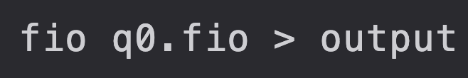
How to use FIO ?
Download FIO first
Prepare an fio file(ex. q0.fio) and then run the command below.
It will begin benchmarking the settings described in your fio file and save the results to an output file. Note that you may need sudo permissions.
What is .fio file？

Slide 6
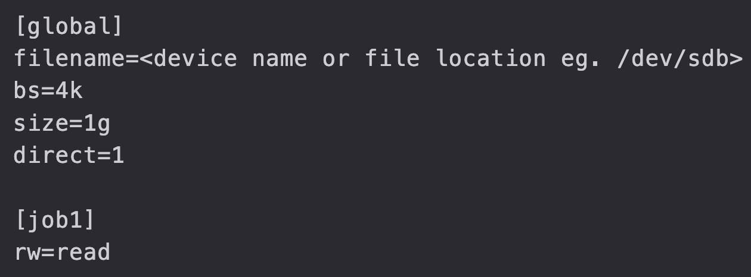
What is .fio file ?
An .fio file (often called a job file) is a plain-text configuration file used by the fio tool to define exactly how a storage benchmark should run.
You will need to adjust different FIO settings for each question in your homework.
For example, you can set rw=read or rw=randread to benchmark different settings; more details can be found on the fio website.
▲ .fio file

Slide 7
Caution !
You can assign the filename parameter to either a specific file path (e.g., /home/kaca/file) or a raw block device (e.g., /dev/sdb).
Writing directly to a raw disk device is destructive. It bypasses the filesystem and partition table, which can permanently overwrite existing data.
To prevent accidental data loss, you should create a pre-allocated test file on a mounted filesystem.
▲ .fio file

Slide 8
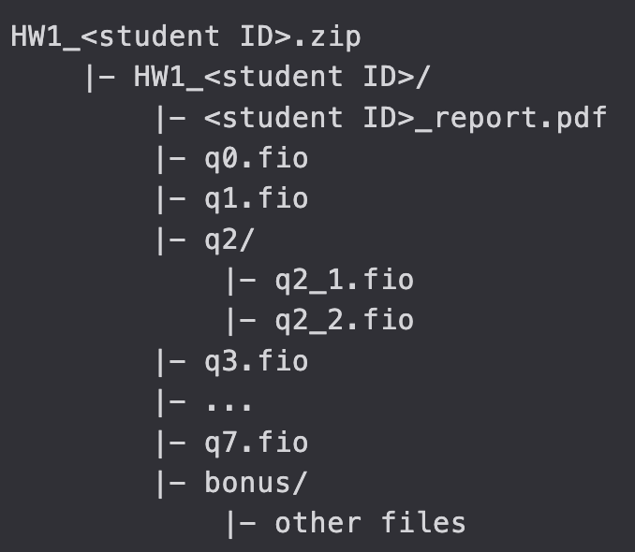
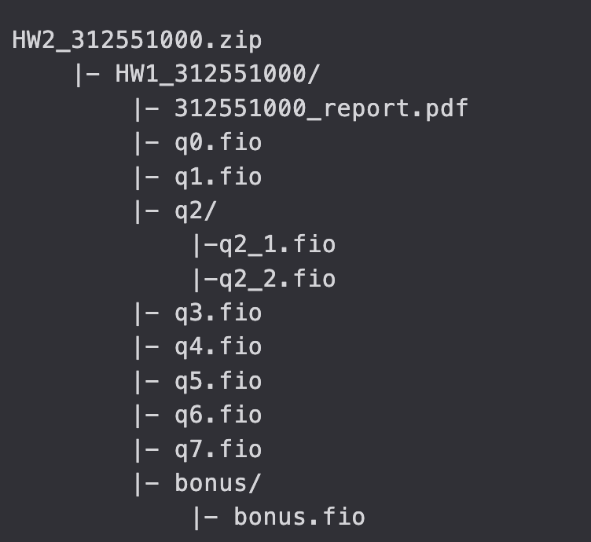
Submission
You will need to answer the questions in a .pdf report
Please attach the .fio source code outside the report additionally
All your files should be organized in the following hierarchy and zipped into a .zip file, named HW1_<student ID>.zip (e.g. HW1_312551000.zip)
Deadline：2026/4/16 - 23:59
▲ submission architecture

Slide 9
Grading Policy
Each question will be classified into one of the following four reward tiers:excellent (100%), good (70%), bad (30%), fail (0%)
You will get NO POINT when
do not follow the submission rule including file name and format.
cheating including any suspected plagiarism in source code or report.
late submission

Slide 10
Question
If you have questions regarding the assignment, please reach out to the TA through the Discussion Forum on E3.

